Slide 1


SMART INDIA HACKATHON 2024
Problem Statement ID – 1555
Problem Statement Title- Create a Virtual Herbal Garden that provides an interactive, educational, and immersive
experience to users, showcasing the diverse range of medicinal plants used in AYUSH (Ayurveda, Yoga & Naturopathy, Unani, Siddha, and Homeopathy).
Theme- MedTech / BioTech / HealthTech
PS Category- Software
Team ID-
Team Name- Error Blaster

Slide 2








Virtual Herbal Garden
Error Blaster
3D Digital Herbarium
Creating an innovative digital
Interactive Features
Allowing users to zoom in/out and
Enhanced Experience
Integrating high quality multimedia elements like images, videos and audio to enhance the learning experience.
Guided Virtual Tours
Providing guided virtual tours highlighting specific themes, such as plants beneficial for digestive health, immunity and skin care.
herbarium with virtual garden tours and interactive 3D models of plants and herbs.
User Interface
The platform will feature sleek and intuitive user interface designed for both elegance and efficiency. By leveraging advanced AI algorithms, we will meet user preferences.
view plants from all angles, including detailed views of leaves, roots and fruits.
Advanced Search Option
Offering advanced search and filter options to easily locate specific plants based on criteria like medicinal use, region and type.
Unique Selling Point(USP)
Comprehensive information for each plant, such as Botanical name, Common name, Sanskrit name, Medicinal uses and habitat, integrated with advanced AI 3D model so that it can be more engaging.
Allowing users to bookmark favorite plant, take notes and share information on social media for increased interactivity.
An engaging, educational and user-friendly platform that promotes appreciation of plant diversity and medicinal value.
2

Slide 3

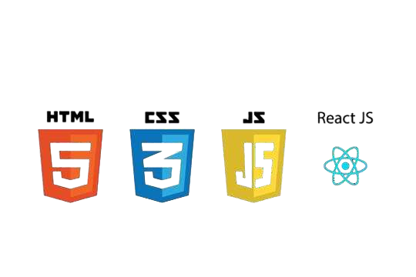
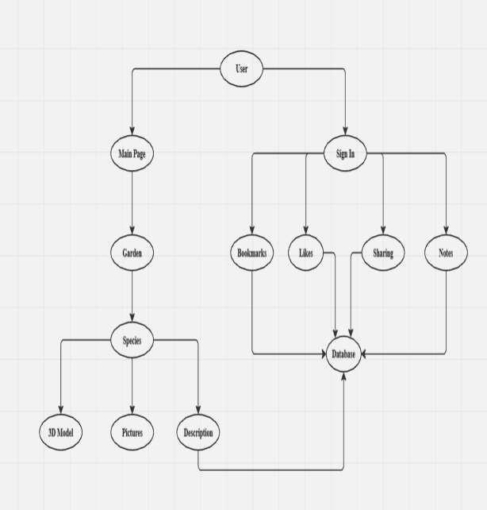





TECHNICAL APPROACH
Error Blaster
Flow Chart
Tech. Stack
Frontend
3D Models
Backend
1

Slide 4

FEASIBILITY AND VIABILITY
Error Blaster
Feasibility:
Potential Challenges & Risks:
Creating Accurate 3D Renderings of Plants and Herbs.
Sourcing High Quality Images of Herbs and Plants from Diverse Habitats.
Increased Risk of System Crashes.
The creation of a digital herbarium featuring 3D interactive models is not only technologically feasible but also a groundbreaking advancement in the field of botany. Imagine exploring a vibrant, interactive library of plant life at your fingertips, where you can examine intricate details and engage with specimens like never before.
Unlock a world of botanical exploration with our advanced search filter options! Designed to simplify your journey, these filters allow you to effortlessly search for plants based on a variety of criteria, including medicinal use, Region and habitat type.
There is a remarkable surge in interest from both students and governments in the field of Ayurveda, signaling a transformative shift towards holistic health and wellness.
Ensuring Long-Term Sustainability: The Key to a Thriving Database with continuous updates, User feedback
incorporation and Technological advancements.
Strategies to overcome Challenges:
Accurate 3D Renderings of Plants and Herbs are created using Advanced AI Algorithms.
Sourcing of High Quality Images of Herbs and Plants
is done from AYUSH (Ayurveda, Yoga & Naturopathy, Unani, Siddha, and Homeopathy) official website.
System crashes are avoided by implementing caching and CDN through which we have distributed the load across various servers, improving performance and reliability.
4

Slide 5







IMPACT AND BENEFITS
Error Blaster
Impact on the Students, Practitioners, and enthusiasts of the AYUSH sector
Educational Value:
Herbal Knowledge
Sustainable Practices
Health and wellness:
Promotion of Natural Remedies
Mental Well-being
Environmental Awareness:
Connection with Nature
Awareness of Herbal Benefits
Economic Impact:
Cost=effective Gardening
Promotion of herbal product
Cultural Connection:
Exploration of Traditions
BENIFITS
Social Benefits:
Increase Social Engagement
Promotion of Healthy Lifestyles
Economic Empowerment
Environmental and Social Responsibility
Economic Benefits:
Market Reach
Support for Local Economies
Skill Development and Employment
Environmental Bebefits:
Biodiversity Conservation
Environmental Awareness
Reduction of Carbon Footprint
1

Slide 6

RESEARCH AND REFERENCES
Error Blaster
Ayush official website https://ayush.gov.in/ used for Data Validation.
https://getbootstrap.com/ is used for Website Framework.
https://spline.design/ is used for 3D Modeling, Design and Deployment.
https://meshy.ai is used for Raw Material.
Ashtanga Hridayam. Chaukhamba Sanskrit Pratishthan, 2000.
Charaka Samhita. Chaukhamba Sanskrit Pratishthan.
6

